Slide 1
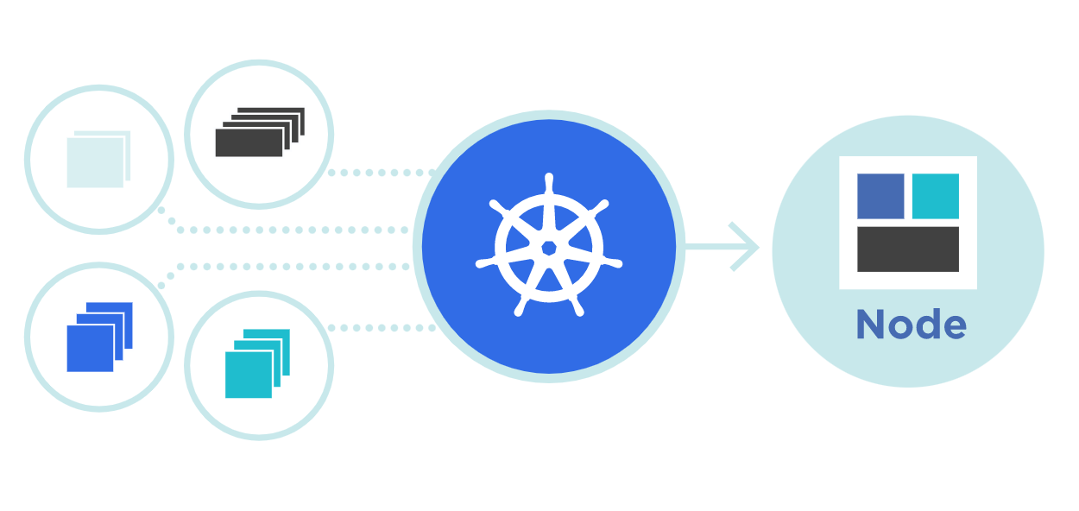



POD
POD
Theory + LAB + Documents ➔ All free
WATCH NOW
Notes:
Hello everyone. My name is Anish Rana and you are watching Kubernetes web series.
As of now, we have successfully completed some topics. If you have not watched those previous videos, then you may click on I button.
Just for your information, this power point document can be downloaded from my Github page. Besides this, subtitle for different language, such as English, French, Russian and German, is available for this video.
Github page : https://github.com/anishrana2001/Kubernetes/tree/main/05%20POD
Kubernetes Series : https://www.youtube.com/watch?v=ijIRe8lwzc4&list=PLu9E__aIIE2kTpa3XySpepuKJYHI_jYC5

Slide 2
POD
POD

Slide 3
We use Kubernetes to manage containers. However, in Kubernetes, container is kept inside the Pod. Now, the question is what is Pod and why it is necessary?
What is Pod?
POD is the smallest, very basic deployable objects in Kubernetes. A single process will be used if you running a Pod. In Pod, we can run multiple containers, and these containers will share the Pod resources (shared storage and network resources, and a specification for how to run the containers).
In simple words, we can say that Pod is a logical boundary of container/s.
We assign the IP @ to POD instead of containers.
Every container in a Pod shares the network namespace, including the IP address and network ports. Inside a Pod (and only then), the containers that belong to the Pod can communicate with one another using localhost.
POD

Slide 4
Kubernetes support multiple runtime engines.
Containerd
CRI-O
Docker Engine
Types of PODs
Static
Dynamic
Static POD

Slide 5
Static POD
Static Pods are managed directly by the kubelet daemon on a specific node, and supervises them (and restarts it if it fails),
It means that API server not monitor them.

Slide 6
Kubelet
KubeProxy
POD
Schedular
Kubelet
CRI
API
workernode1
Controller
Kubelet
ETCD
KubeProxy
master
CRI
workernode2
Kubelet
KubeProxy
POD
CRI
workernode3

Slide 7
Static POD
Static Pods are managed directly by the kubelet daemon on a specific node, and supervises them (and restarts it if it fails),
It means that API server not monitor them.
The main use for static Pods is to run a self-hosted control plane: in other words, using the Kubelet to supervise the individual control plane components.

Slide 8
Kubelet
KubeProxy
POD
Schedular
Kubelet
CRI
API
workernode1
Controller
Kubelet
ETCD
KubeProxy
master
CRI
workernode2
Kubelet
KubeProxy
POD
CRI
workernode3

Slide 9
Static POD
Static Pods are managed directly by the kubelet daemon on a specific node, and supervises them (and restarts it if it fails),
It means that API server not monitor them.
The main use for static Pods is to run a self-hosted control plane: in other words, using the Kubelet to supervise the individual control plane components.
The Kubelet automatically tries to create a mirror Pod on the Kubernetes API server for each static Pod. This means that the Pods running on a node are visible on the API server but cannot be controlled from there.
Static Pods are always bound to one Kubelet on a specific node.

Slide 10
Pod can be created by Yaml file or through command line
Yaml file for POD:
++++++++++++++++++++++
apiVersion: v1
kind: Pod
metadata:
name: nginx
spec:
containers:
- name: nginx
image: nginx:1.14.2
ports:
- containerPort: 80
++++++++++++++++++++++++++++

Slide 11
[root@workernode1 ~]# ps aux | grep kubelet
root 771 0.5 5.0 1935128 114504 ? Ssl 21:55 0:35 /usr/bin/kubelet --bootstrap-kubeconfig=/etc/kubernetes/bootstrap-kubelet.conf --kubeconfig=/etc/kubernetes/kubelet.conf --config=/var/lib/kubelet/config.yaml --container-runtime=remote --container-runtime-endpoint=unix:///var/run/containerd/containerd.sock --pod-infra-container-image=registry.k8s.io/pause:3.8
root 42991 0.0 0.0 221796 2260 pts/0 S+ 23:45 0:00 grep --color=auto kubelet
staticPodPath: /etc/kubernetes/manifests
[root@workernode1 ~]#
cat /var/lib/kubelet/config.yaml | grep -i static

Slide 12
Static POD
URL: https://kubernetes.io/docs/tasks/configure-pod-container/static-pod/
[root@workernode1 manifests]# cat <<EOF >/etc/kubernetes/manifests/static-web.yaml
apiVersion: v1
kind: Pod
metadata:
name: static-web
labels:
role: myrole
spec:
containers:
- name: web
image: nginx
ports:
- name: web
containerPort: 80
protocol: TCP
EOF
[root@master1 ~]# kubectl get pods
NAME READY STATUS RESTARTS AGE
static-web-workernode1.example.com 0/1 ContainerCreating 0 8s
[root@master1 ~]# kubectl get nodes
NAME STATUS ROLES AGE VERSION
master1.example.com Ready control-plane 21d v1.25.4
workernode1.example.com Ready <none> 21d v1.25.4
workernode2.example.com Ready <none> 21d v1.25.4
[root@master1 ~]#

Slide 13
Dynamic POD
Dynamic Pods are being managed by Controller.

Slide 14
How can we create a pod from command line?
[root@master1 ~]# kubectl run test-pod1 --image=nginx
pod/test-pod1 created
[root@master1 ~]# kubectl get pods
NAME READY STATUS RESTARTS AGE
static-web-workernode1.example.com 1/1 Running 1 (7h10m ago) 19h
test-pod1 1/1 Running 0 56s
[root@master1 ~]#
[root@master1 ~]# kubectl run test-pod2 --image=nginx --dry-run=client
pod/test-pod2 created (dry run)
[root@master1 ~]# kubectl get pods
NAME READY STATUS RESTARTS AGE
static-web-workernode1.example.com 1/1 Running 1 (7h13m ago) 19h
test-pod1 1/1 Running 0 4m1s
[root@master1 ~]#

Slide 15
Create a yaml file from command
[root@master1 ~]# kubectl run test-pod2 --image=nginx --dry-run=client -o yaml
apiVersion: v1
kind: Pod
metadata:
creationTimestamp: null
labels:
run: test-pod2
name: test-pod2
spec:
containers:
- image: nginx
name: test-pod2
resources: {}
dnsPolicy: ClusterFirst
restartPolicy: Always
status: {}
[root@master1 ~]# kubectl get pods
NAME READY STATUS RESTARTS AGE
static-web-workernode1.example.com 1/1 Running 1 (7h13m ago) 19h
test-pod1 1/1 Running 0 4m15s
[root@master1 ~]#

Slide 16
A Pod with two containers
STEP 2:
vi question1.yaml
cat question1.yaml
apiVersion: v1
kind: Pod
metadata:
creationTimestamp: null
labels:
run: mypod
name: mypod
spec:
containers:
- image: nginx:1.14.2
name: nginx
resources: {}
- image: redis
name: redis
dnsPolicy: ClusterFirst
restartPolicy: Always
status: {}
[root@master1 ~]#
Need to create one POD named mypod and it should have two containers.
name= nginx
image= nginx:1.14.2
name=redis
image=redis
Solution: Step 1:
kubectl run mypod --image=nginx:1.14.2 --dry-run=client -o yaml > question1.yaml
Step 3: kubectl create -f question1.yaml
Step 4: kubectl get pods -w
NAME READY STATUS RESTARTS AGE
mypod 0/2 ContainerCreating 0 10s
static-web-workernode1.example.com 1/1 Running 1 (7h26m ago) 19h
test-pod1 1/1 Running 0 17m
mypod 2/2 Running 0 28s

Slide 17
POD commands
kubectl get pods
kubectl create –f <pod yaml>
kubectl describe pods nginx
kubectl get pod nginx -o wide
kubectl exec pods/nginx -it -- /bin/sh
kubectl exec nginx -c nginxc1 -it -- /bin/sh
kubectl logs pods/nginx
kubectl logs pods/nginx -c nginxc1
kubectl delete pod nginx
kubectl delete pod nginx --timeout 0 --force

Slide 18
Pod Phase
Value | Description
Pending | The Pod has been accepted by the Kubernetes cluster, but one or more of the containers has not been set up and made ready to run. This includes time a Pod spends waiting to be scheduled as well as the time spent downloading container images over the network.
Running | The Pod has been bound to a node, and all the containers have been created. At least one container is still running or is in the process of starting or restarting.
Succeeded | All containers in the Pod have terminated in success and will not be restarted.
Failed | All containers in the Pod have terminated, and at least one container has terminated in failure. That is, the container either exited with non-zero status or was terminated by the system.
Unknown | For some reason, the state of the Pod could not be obtained. This phase typically occurs due to an error in communicating with the node where the Pod should be running.

